Slide 1
Darkstar
John, Ya-Ching, Akash, Lynne, Rick
Jesse

Slide 2
Client Project: SUN MICROSYSTEMS
Point of Contact:
Jim Waldo
Project Darkstar Director:
Karl Haberl

Slide 3
WHAT IS DARKSTAR?
Sun Microsystems
Open Source
Server side framework
For MMOGs

Slide 4
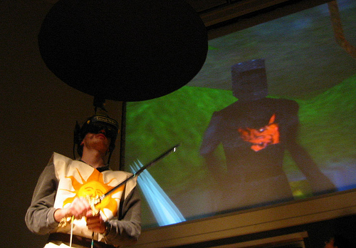
WHAT ARE WE DOING?
API Usability Testing
Making Games
BVW Deployment
Panda3D Integration

Slide 5
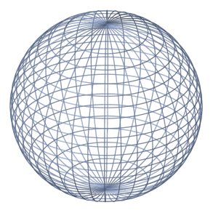
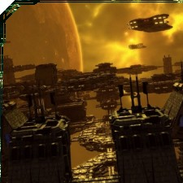
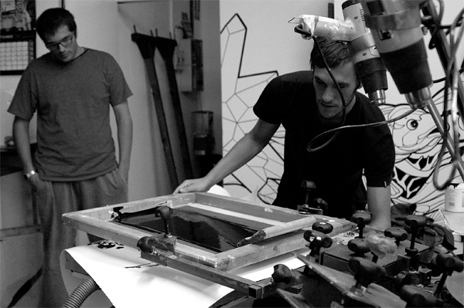
CURRENTLY
5 Tech Demos
MMO Underway
BVW Deployed
Panda3D Integration

Slide 6
GAMEPLAY
Gameplay

Slide 7
GAMEPLAY
Pirate
Attack!!
Trade items
Win the mini game,
Save the planet.
Player’s ship

Slide 8
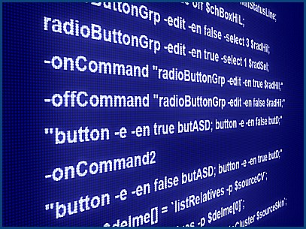
PRE-DEMO
Caveat:
5 Programmers
0 Artists

Slide 9
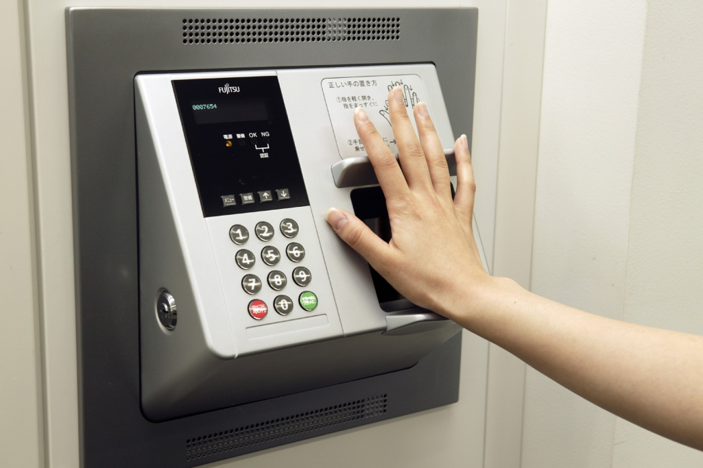
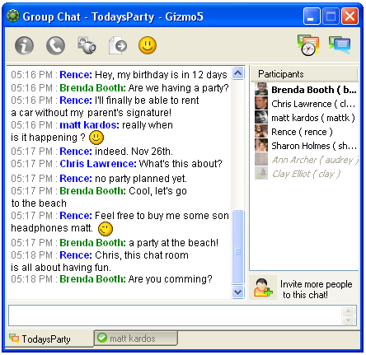
SERVER FRAMEWORK
Above the Hood:
Login System
Waiting Rooms
Trade System
Chat System

Slide 10
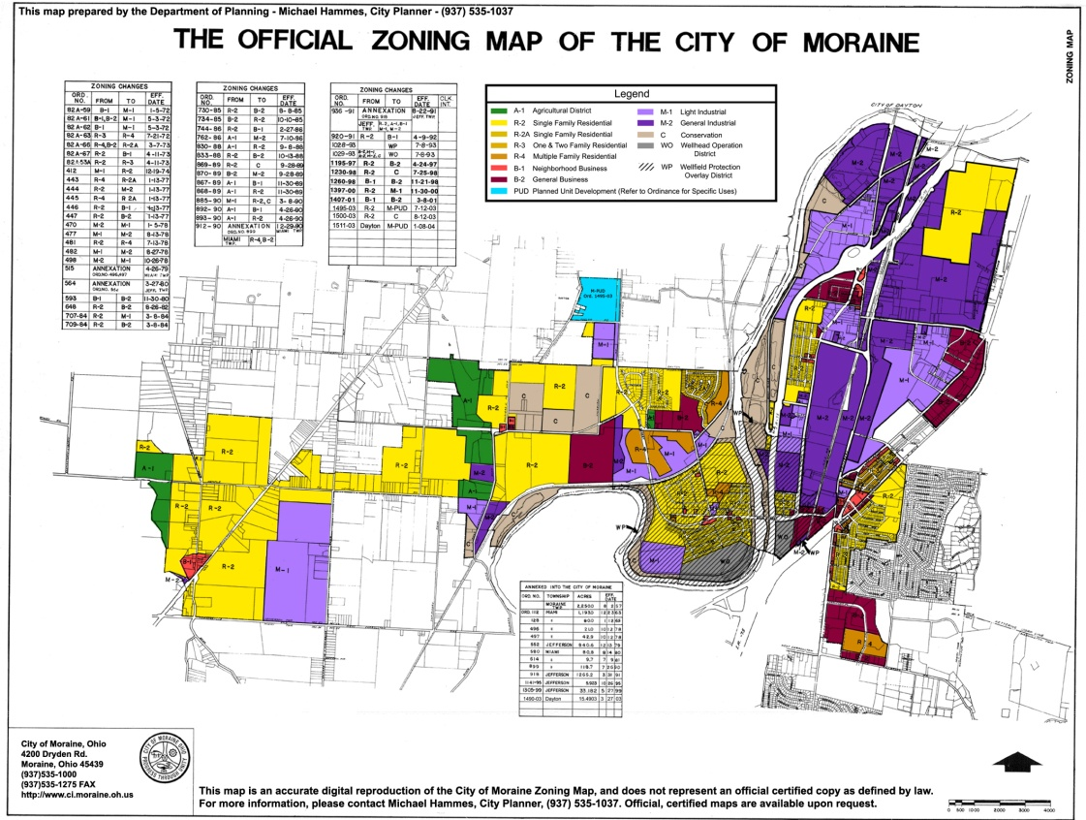
FRAMEWORK OF A SERVER
Under the Hood:
Generic Zoning
Persistence
Generic Networking

Slide 11
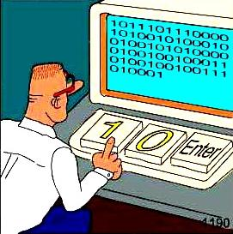
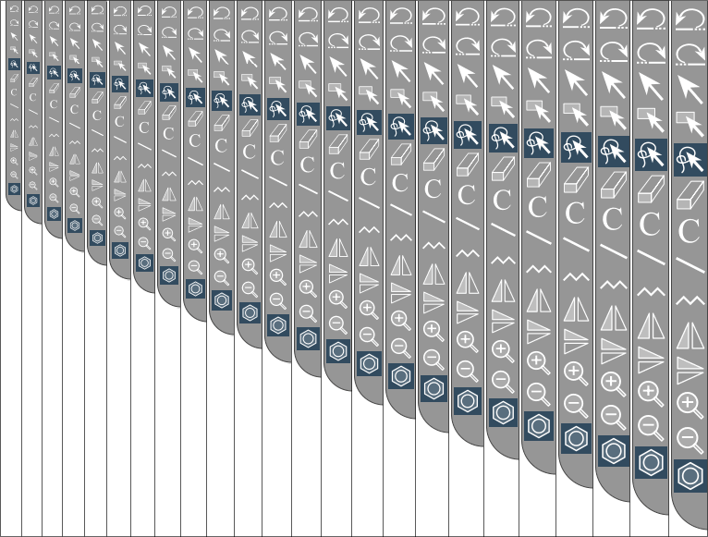
MASSIVE DEMO
Keeping It Simple
And Scalable

Slide 12
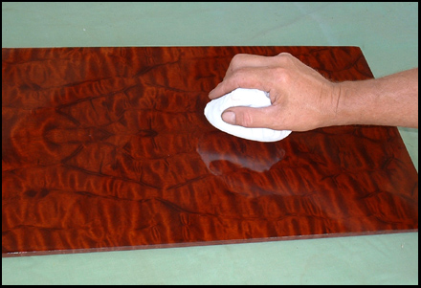
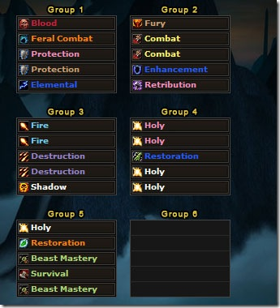
FORTHCOMING
Demo Polish
MMO Work
Continued BVW Support
Panda3D Integrated

Slide 13
QUARTER’S FEEDBACK
Project Darkstar?
Aggressive Scope
Panda3D Integration

Slide 14
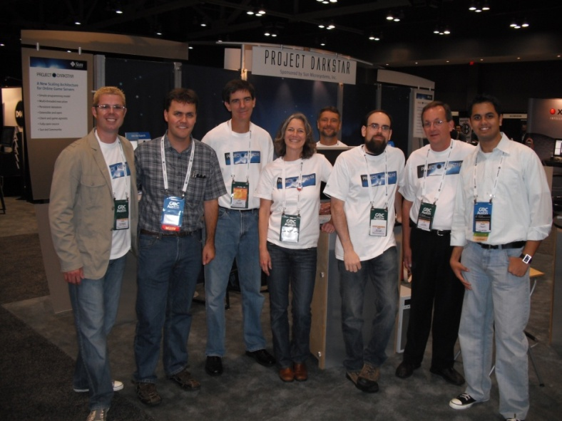
CLIENT FEEDBACK
“You folks are, without doubt, the most professional group of students we have ever worked with.” – Jim Waldo
Getting the feedback they need from us.

Slide 15
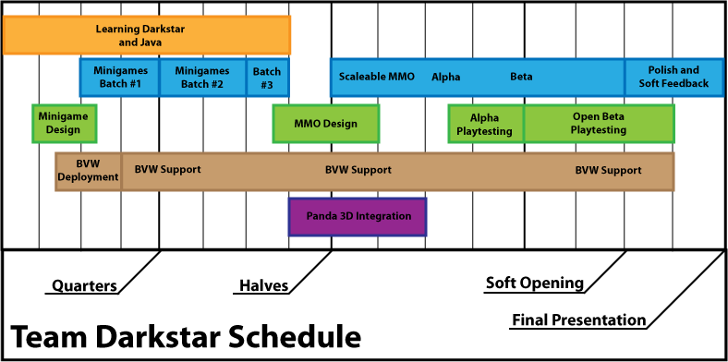
SCHEDULE

Slide 16
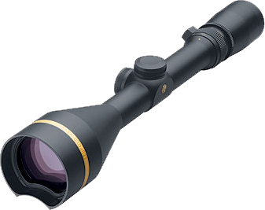
Risks
Upcoming Darkstar Build
Art
Scope

Slide 17
THANK YOU
Jim Waldo
Karl Haberl
Jesse Schell
Ruth Comely
Mike Christel
PandAI
BVW Students

Slide 18
QUESTIONS?

